Slide 1

Selenium with Nunit
Phung Ngo Viet Tien
October, 2022

Slide 2
Agenda
1. Nunit Introduction
2. Set Up Environment
3. Writing and Organization Test
4. Practice
5. QA

Slide 3
Nunit Introduction

Slide 4
What is Nunit ?
Nunit is an open-source testing framework ported from JUnit. The latest version of NUnit is NUnit3 that is rewritten with many new features and has support for a wide range of .NET platforms.
NUnit has been downloaded more than 126 million times from NuGet.org. This shows the popularity of NUnit within the .NET user community. As of writing this article, there were close to 24,000 questions tagged as NUnit on Stackoverflow. It is a popular test framework used for test automation. If you are planning to perform Test-Driven Development (TDD) with C#, you should have a close look at the NUnit framework.

Slide 5
Advantages Of NUnit Testing For Selenium
NUnit is preferred over other test frameworks as it is compatible with Selenium testsuite. NUnit testing for Selenium automation is widely used due to the following advantages over other test frameworks:
Annotations used in NUnit help in speeding up test development & execution as tests can be executed with numerous input values.
TDD is primarily useful as unit tests are instrumental in finding issues/bugs during the early stages of product development. NUnit test framework can be used with Selenium if you plan to use TDD (Test Driven Development) for the test activity.
Provides you the ability to run your test cases in parallel.
Using NUnit, you can execute test cases from console runner by either a third-party automation testing tool or by the NUnit Test Adapter inside the Visual Studio.

Slide 6
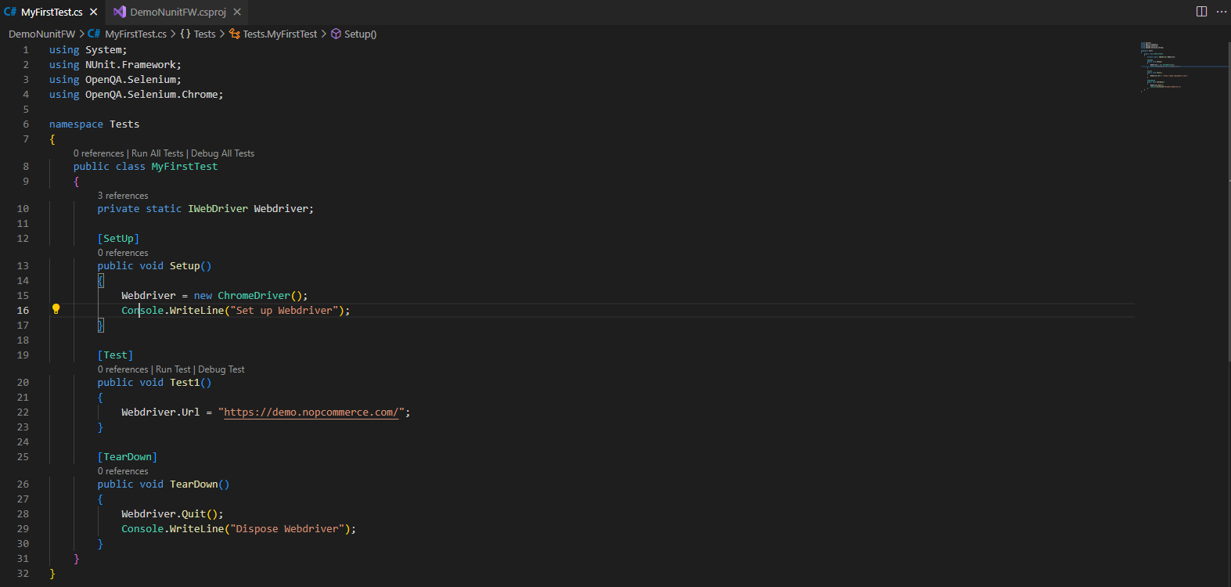
Nunit Sample Code

Slide 7
Set Up Environment

Slide 8
Prerequisites
Install Visual Code
Install dotnet SDK
Setup Visual Code for .Net Development
Install Selenium and Selenium Support Library from Nuget package
https://code.visualstudio.com/docs/languages/dotnet

Slide 9
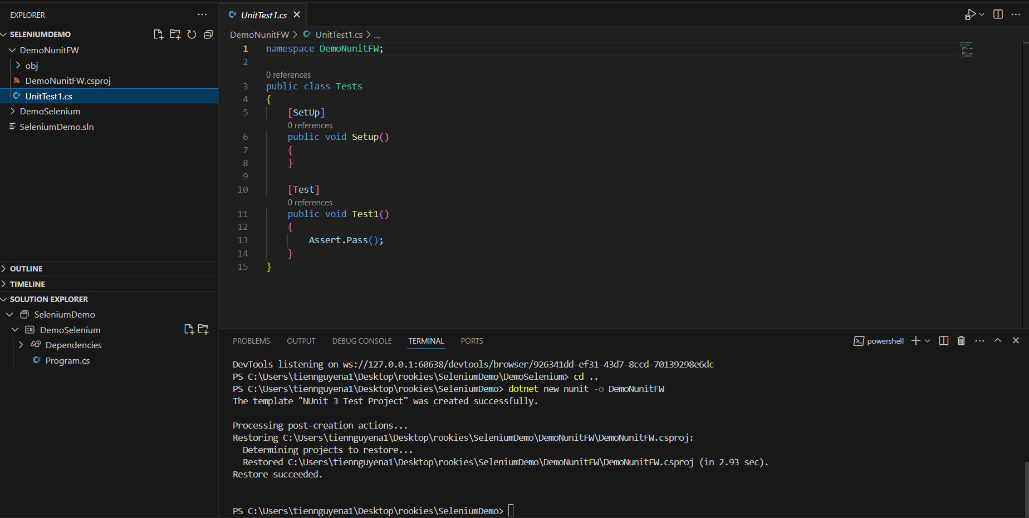
Create nunit test project
Execute following command in Terminal Window: dotnet new nunit -o DemoNunitFW

Slide 10
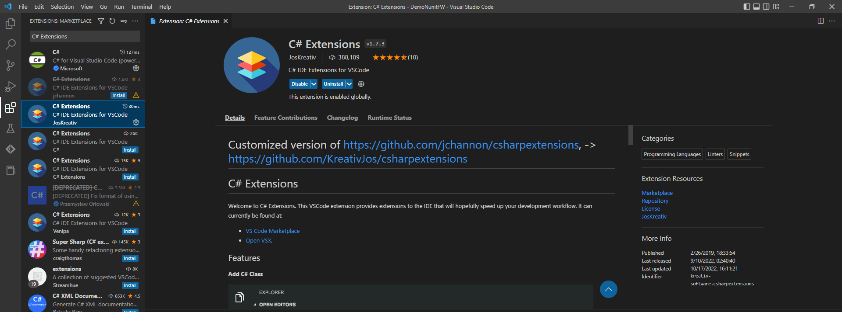
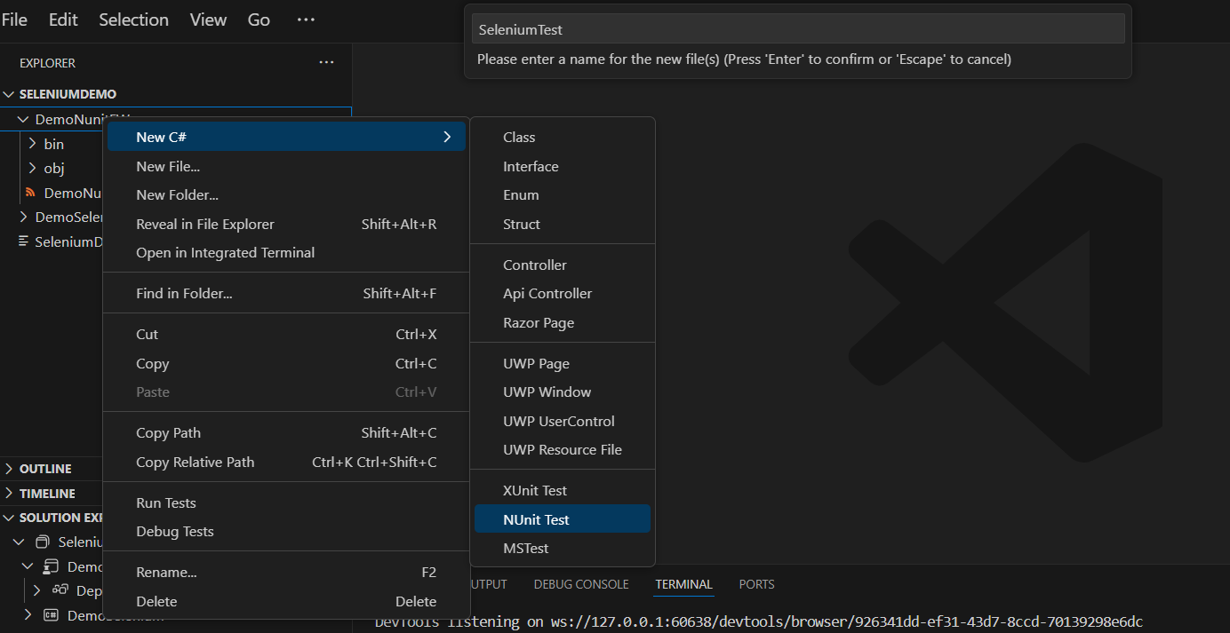
Create nunit test class
Install C# Extensions from Extension Window. After complete installing, we can add new C# class from menu

Slide 11
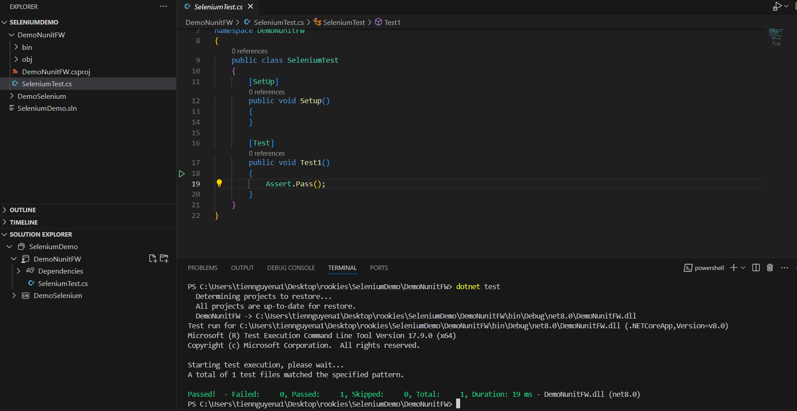
Execute test
Try running “dotnet test” to execute the test case

Slide 12
Writing and Organization Test
Nunit Annotations
Test Structure
Using Hooks
Assertion
Page Factory

Slide 13
Nunit Annotations

Slide 14
Nunit Annotations
DESCRIPTION | Annotations
Marks a test method/individual test | [Test]
Marks a method with parameters and provides the inline arguments. | [TestCase]
Indicates that a class has a group of unit tests | [TestFixture]
Ignores a test case | [Ignore(“reason”)]
Categorize test cases or classes | [Category()]
Contains the initialization code, which is triggered before every test case | [SetUp]
Contains the cleanup code, which is triggered after every test case | [TearDown]
Contains method that is triggered once before test cases start | [OneTimeSetUp]
Contains method that is triggered once before test cases end | [OneTimeTearDown]
https://docs.nunit.org/articles/nunit/writing-tests/attributes/test.html

Slide 15
Test Structure

Slide 16
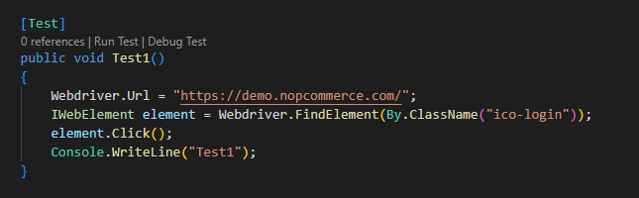
Test
The Test attribute is one way of marking a method inside a TestFixture class as a test.

Slide 17
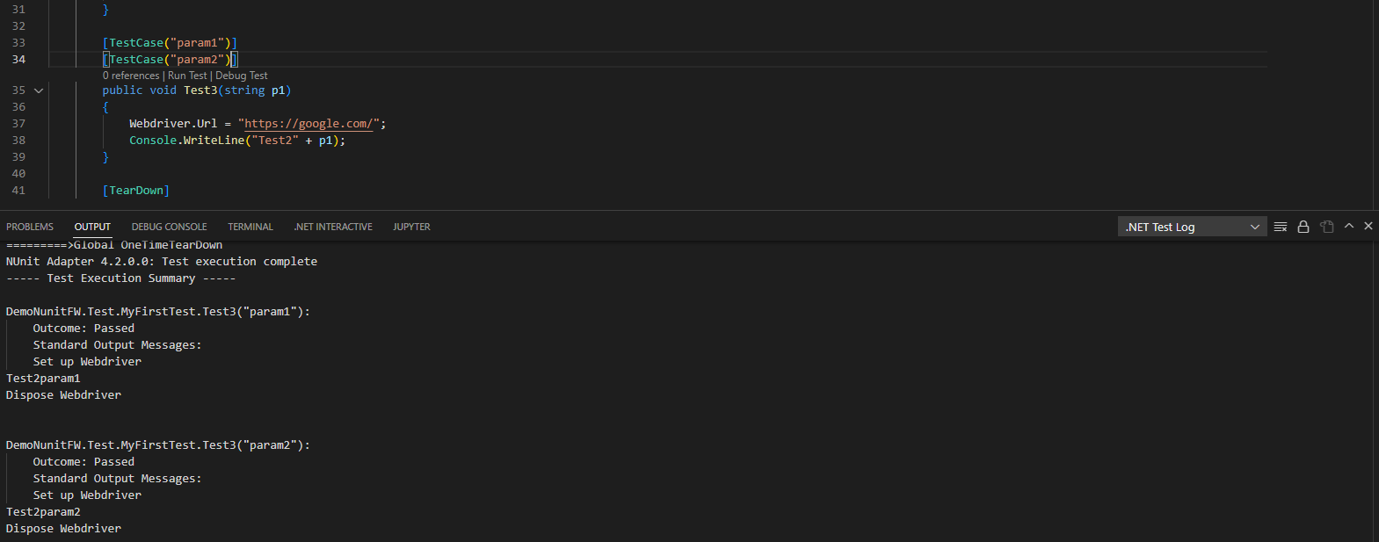
Test Case
TestCaseAttribute serves the dual purpose of marking a method with parameters as a test method and providing inline data to be used when invoking that method

Slide 18
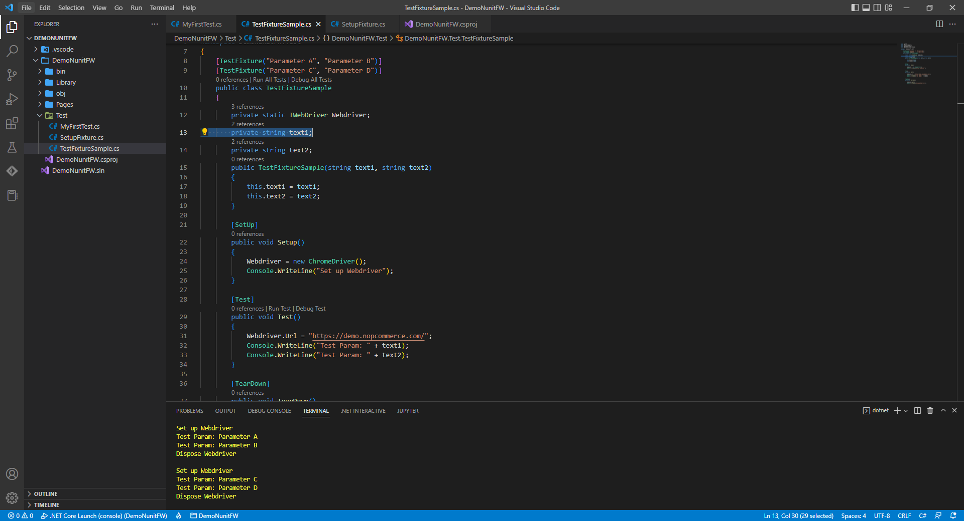
Test Fixture
The TestFixture attribute is optional for non-parameterized, non-generic fixtures. So long as the class contains at least one method marked with the Test, TestCase or TestCaseSource attribute, it will be treated as a test fixture.

Slide 19
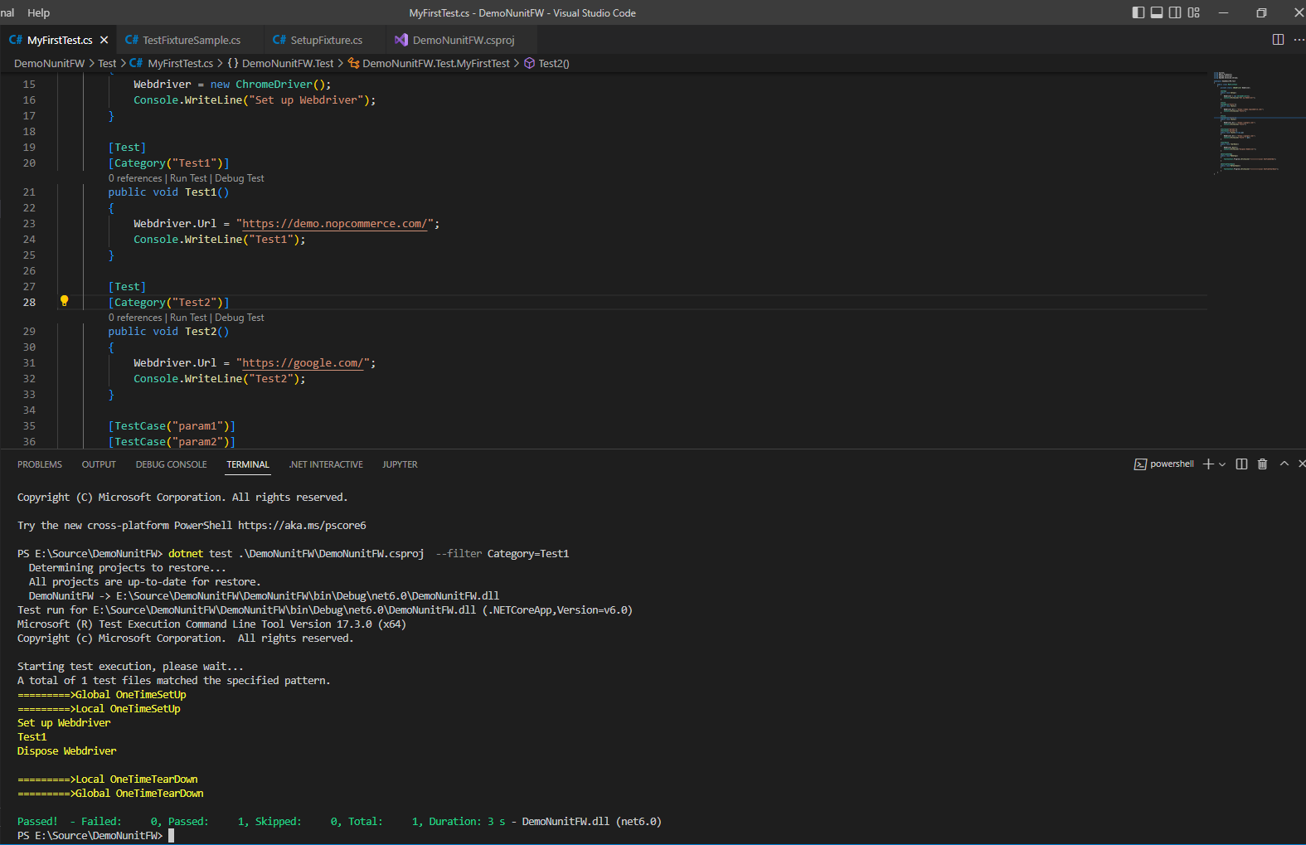
Category
The Category attribute provides an alternative to suites for dealing with groups of tests. Either individual test cases or fixtures may be identified as belonging to a particular category.
dotnet test .\DemoNunitFW\DemoNunitFW.csproj --filter Category=Test1

Slide 20
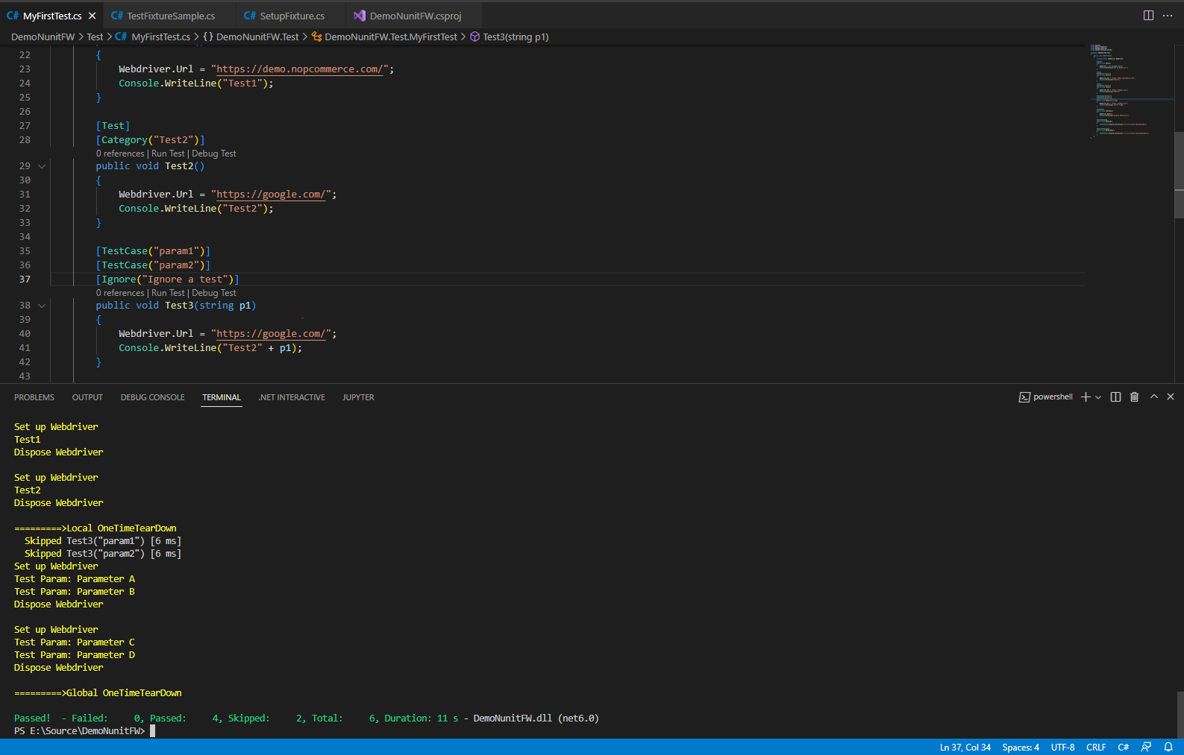
Ignore
IgnoreAttribute is used to indicate that a test should not be executed for some reason.

Slide 21
Using Hooks

Slide 22
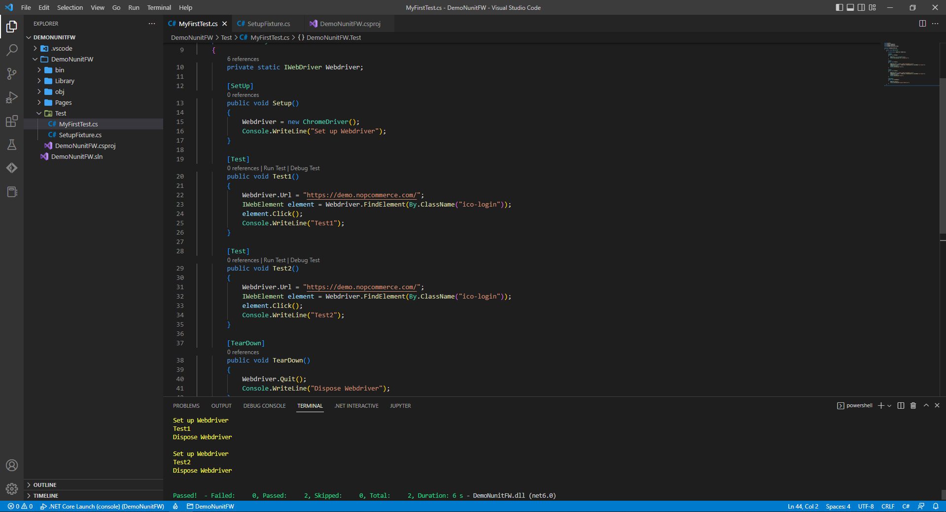
Setup/Teardown before each tests start/complete

Slide 23
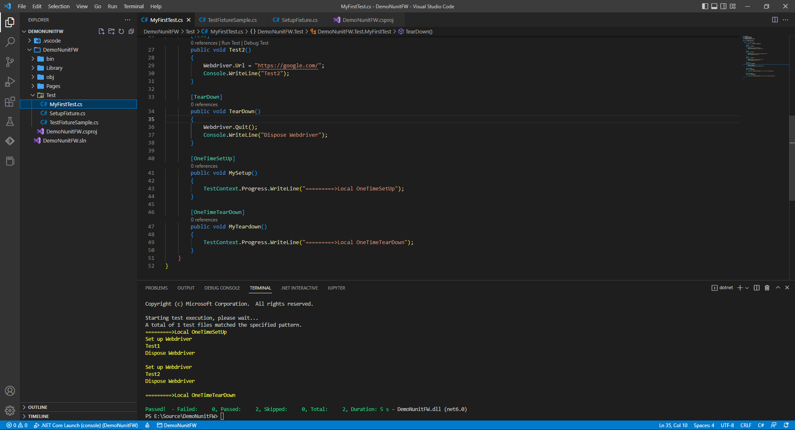
Setup/Teardown before/after all tests in Test Class start/complete

Slide 24
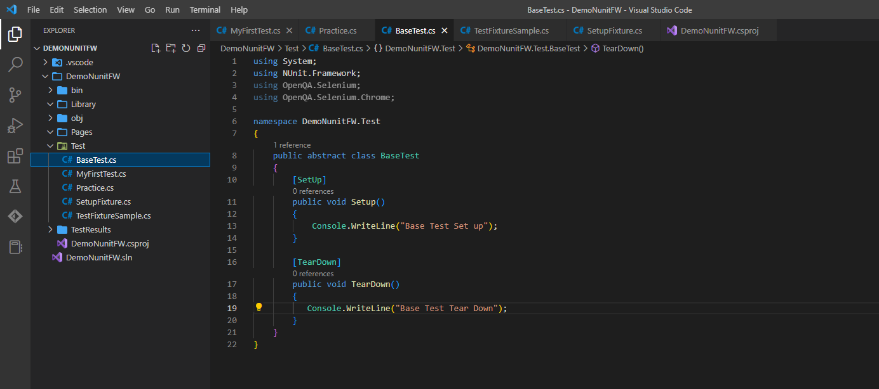
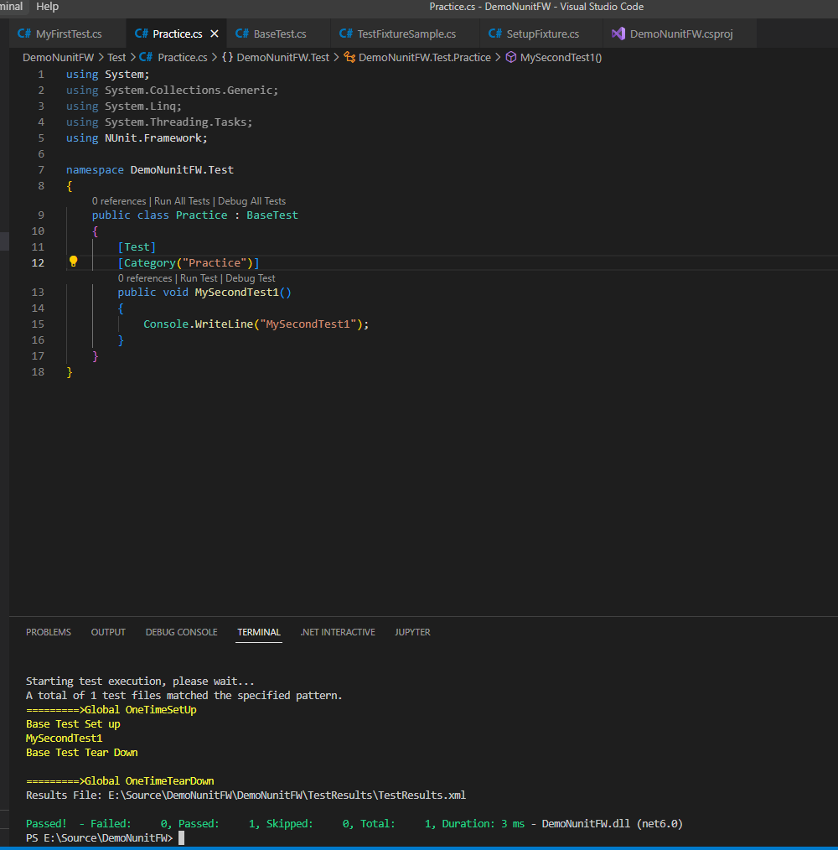
Global Hooks – Base Test

Slide 25
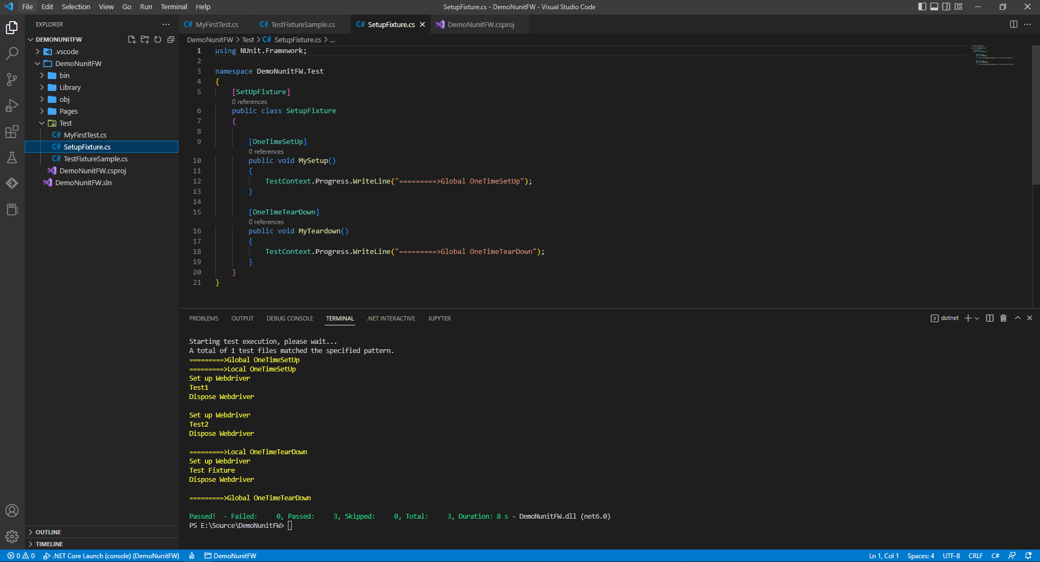
Global Hooks – Setup/TearDown before/after all Tests in project start / complete

Slide 26
Assetions

Slide 27
Assertions
NUnit provides a rich set of assertions as static methods of the Assert class. If an assertion fails, the method call does not return and an error is reported. If a test contains multiple assertions, any that follow the one that failed will not be executed.
Assertions for Nunit have 2 models: Constraint Model and Classic Model. This Classic Model is still supported but since no new features have been added to it for some time, the constraint-based model must be used in order to have full access to NUnit's capabilities.

Slide 28
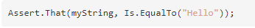
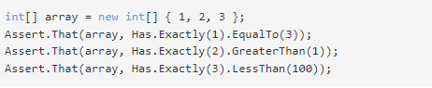
Assertions - Constraint Model (Assert.That)
The constraint-based Assert model uses a single method of the Assert class for all assertions. The logic necessary to carry out each assertion is embedded in the constraint object passed as the second parameter to that method.
https://docs.nunit.org/articles/nunit/writing-tests/assertions/assertion-models/constraint.html
https://docs.nunit.org/articles/nunit/writing-tests/constraints/Constraints.html

Slide 29
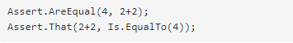
Assertions - Classic Model
The classic Assert model uses a separate method to express each individual assertion of which it is capable.
https://docs.nunit.org/articles/nunit/writing-tests/assertions/assertion-models/classic.html

Slide 30
Page Object Model

Slide 31
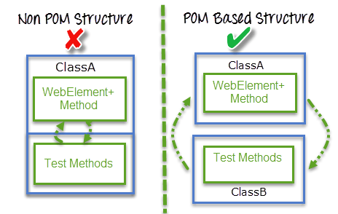
Page Object Design Pattern
Page Object Model in Selenium C# is a design pattern that is extensively used by the Selenium community for automation tests. The basic design principle that the Page Object Model in Selenium C# follows is that a central object repository should be created for controls on a web page. Hence, each web page will be represented by a separate class.
Advantages of using Page Object Pattern:
Easy to Maintain
Easy Readability of scripts
Reduce or Eliminate duplicacy
Re-usability of code
Reliability

Slide 32
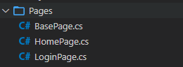
Use POM:
1. Create Base Page class where contains selenium methods
2. Create Web Page classes
Base Class
Web Pages Classes

Slide 33
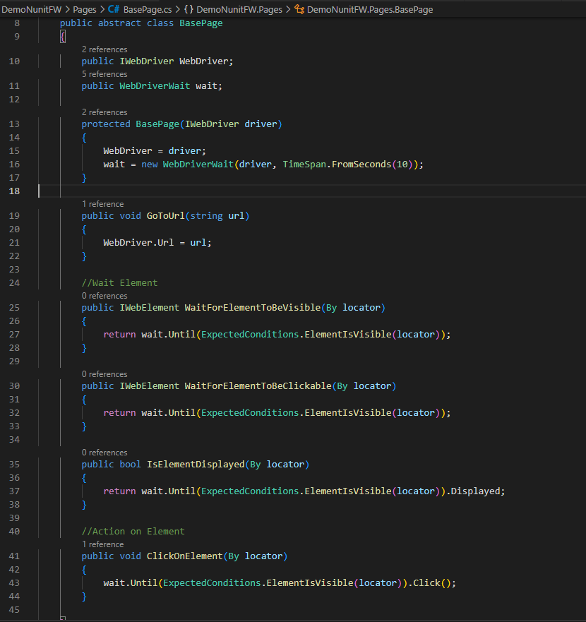
Base Page

Slide 34
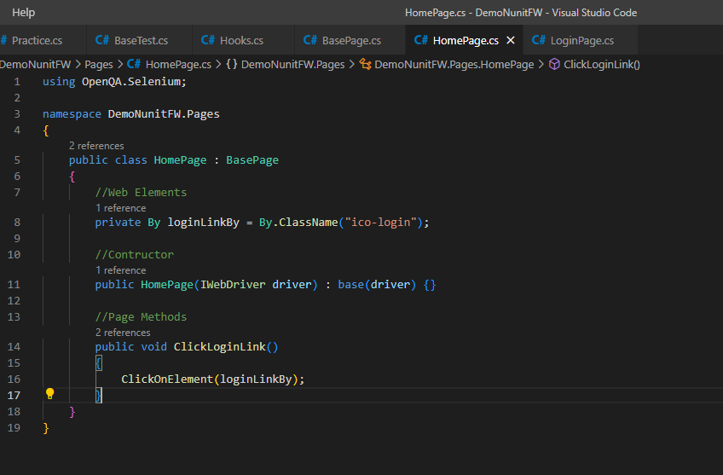
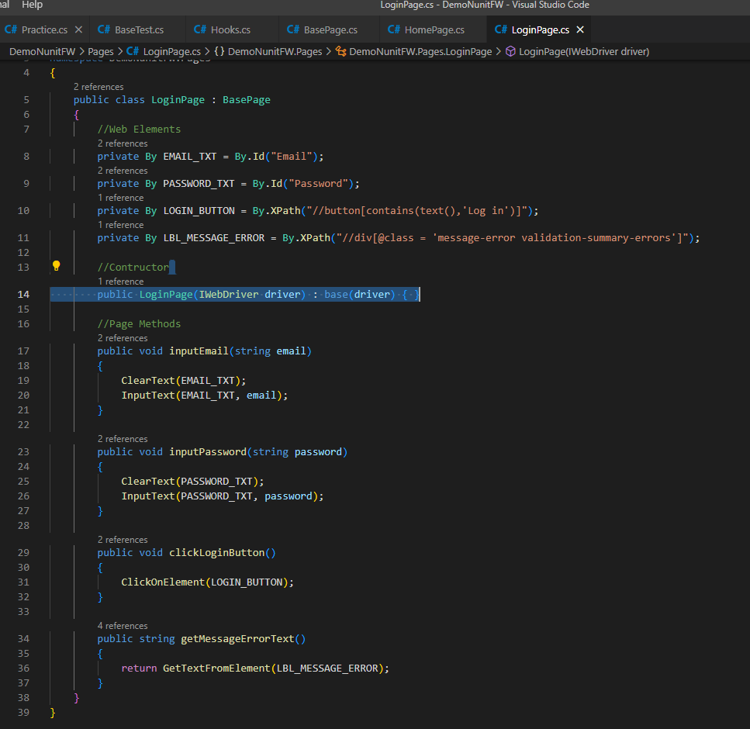
Home Page and Login Page

Slide 35
Practices

Slide 36
Test Case
Scenario:
Given the user is on Home Page
And the user clicks on Login link
When the user inputs invalid email and password
And the user clicks on Login button
Then error message is shown correctly

Slide 37
Base Page

Slide 38
Home Page and Login Page

Slide 39
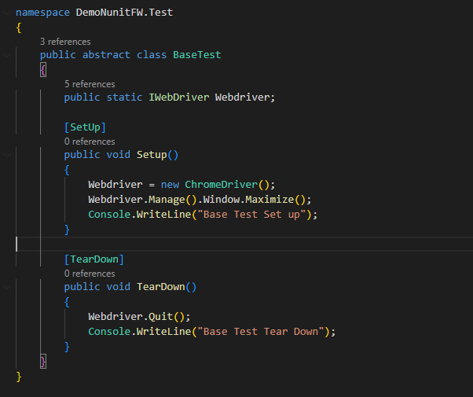
Test Case – Create Base Test

Slide 40
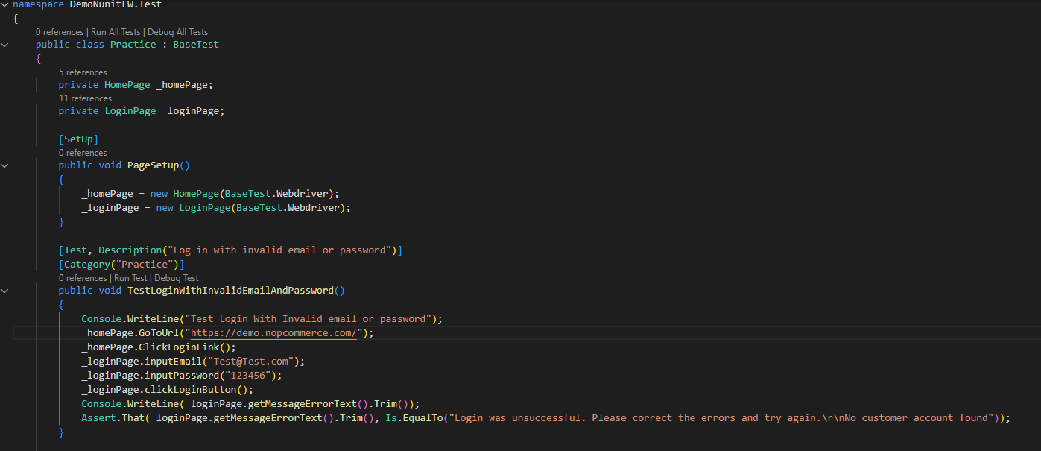
Test Case Implement

Slide 41
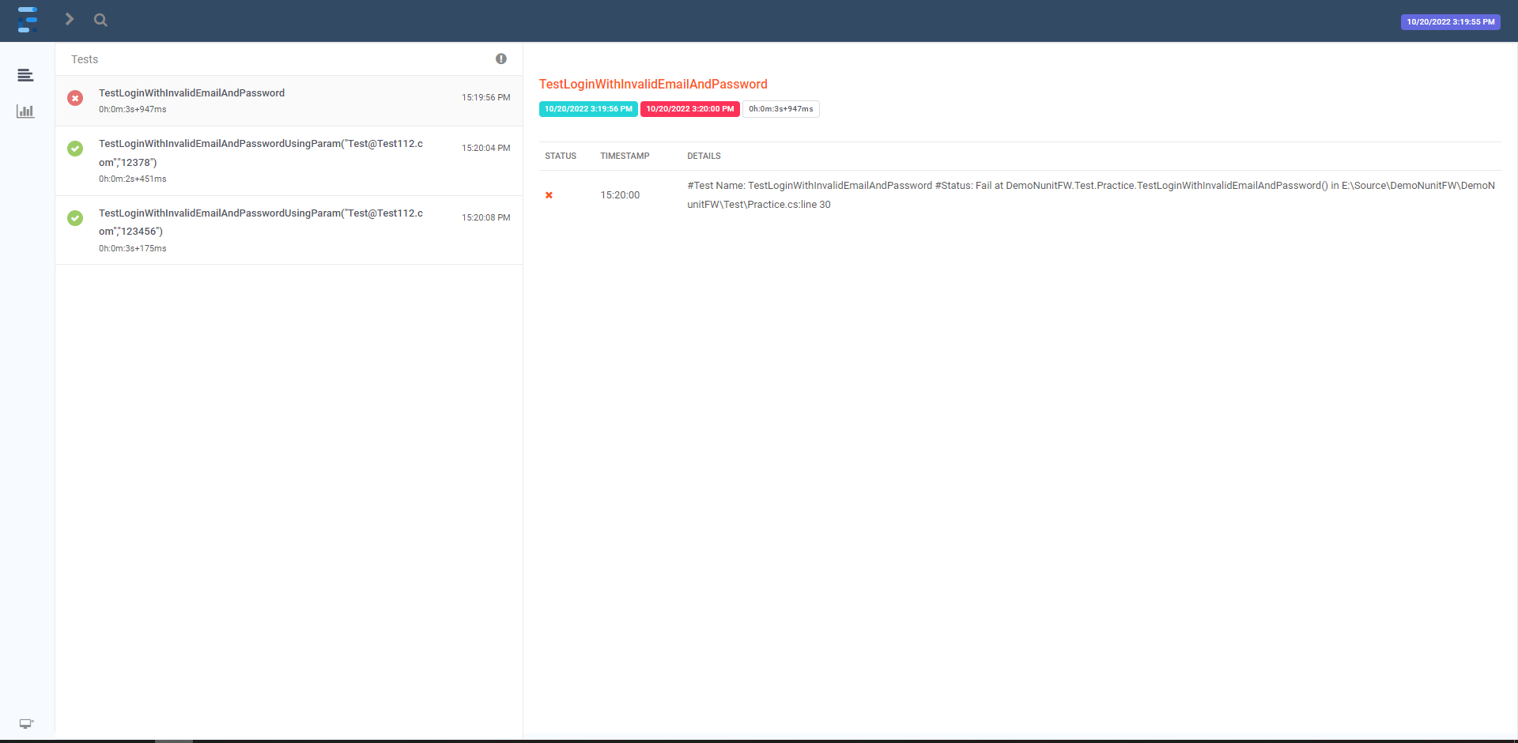
Report

Slide 42
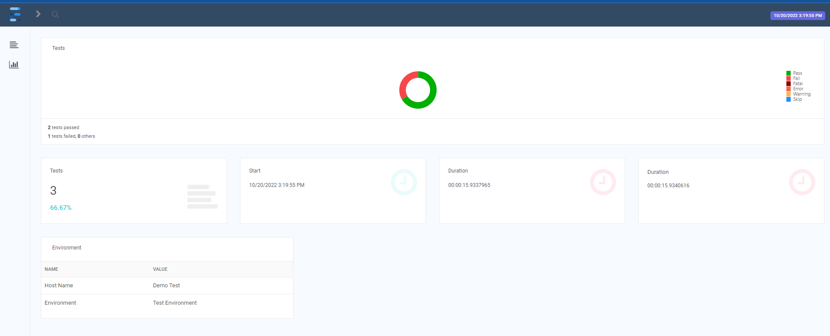
Report – Dashboard

Slide 43



Slide 44
Homework
Implement the below test script
- Test Application: http://192.168.237.10:3000
- Account (User name: Admin2Pass, qp$#tGu^)
Scenario 1: Create new project
Given the user logs into the application
And the user is on Create Project page
When the user fills in all project information
And the user clicks Create button
Then all information of the project is shown.

Slide 45
Homework
Scenario 2: Search project
Given the user logs into the application
And the user is on the Search Project page
When the user applies some search criteria
And the user clicks on Search button
Then all projects matched with input criteria will be displayed.

Slide 46
THANK YOU

